Slide 1
CLVT Analysis
Onur AKCAKAYA

Slide 2
CLTV-Final Project
Business Problem
Data Story
Variable Description
Aim
Method
Results
Recommendations

Slide 3

1-Business Problem
An UK based e-commerce company wants evaluate their UK based customers according to their future purchases. Following tasks are asked:
6 months of purchases and customer evaluation
Comparison of 1-month and 12-months prediction
Customer segmentation of 3 groups for 6-months prediction (C,B,A)
Recommend 6-months action for each segment

Slide 4
2-Data Story
The data set “Online Retail II” contains transaction records of an UK based e-commerce store between 12.01.2019-12.09.2011
Items listed are souvenirs also can be considered as promotional items
Majority of the customers are wholesale traders

Slide 5
3-Variables
• InvoiceNo: Invoice number. Nominal. A 6-digit integral number uniquely assigned to each transaction. If this code starts with the letter 'c', it indicates a cancellation.\n
• StockCode: Product (item) code. Nominal. A 5-digit integral number uniquely assigned to each product.\n
• Description: Item name and description. Nominal.\n
• Quantity: The quantities of each item per transaction. Numeric.\n
• InvoiceDate: Invoice date and time. Numeric.\n
• UnitPrice: Unit price. Numeric. Product price per unit (£).\n
• CustomerID: Customer number. Nominal. A 5-digit number uniquely assigned to each customer.\n
• Country: Country name. Nominal. The name of the country where a customer resides.

Slide 6

4-AIM
Aim of the project is to define customer value in a specific time according to their future purchases

Slide 7
5-METHOD
Dataset obtained from: https://archive.ics.uci.edu/ml/machine-learning-databases/00502/
Missing values and “Cancelled” transactions are dropped from the data set
TotalPrice column created for each invoice by using “Price” and “Quantity” Columns
recenc_cltv_p, T, frequency & monetary_avg values are calculated and columns are created
BG/NBD model deployed and expected_number_of_purchases are calculated
Gamma-Gamma model deployed and expected_average_profit are calculated then CLTV are calculated.
Interpretations and recommendations are based on CLTV prediction model.

Slide 8
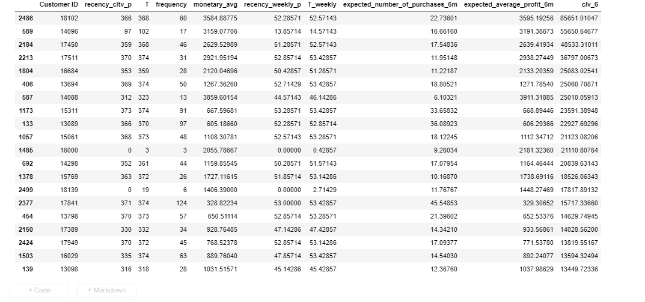
7-Result

Slide 9
7-Result
The model predicts customer values according to their expected number of purchases and expected average profit.
Frequent buyers with high average monetary values have increased CLV’s since they are loyal and dependable customers.
Two customers, 16000 and 18139 are noticeable in the table. Even though their frequency and recency score are low, because of the high monetary value their CLVs are high. They are potential “Champions” but they need to be monitored and encouraged to make more frequent purchases
Longtime frequent buyers should be rewarded since they are the most valuable type of customer according to model

Slide 10
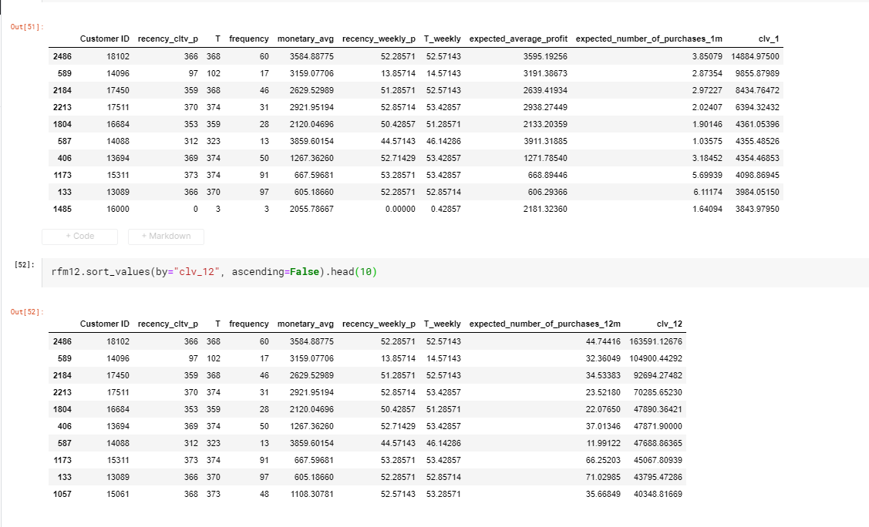
7-Result

Slide 11
7-Result
When 1-month and 12-months CLTV compared:
Top 10 customers are almost the same except two lines
Customers 14088 & 13694 interchanged their orders. When making predictions in longer time periods, frequent buyers and higher tenure customers are more stable even their monetary average is low
In the first table, 10th row customer 16000 is a rising star in short term (1month) with a higher average monetary value, in longer term a loyal-long term customer 15061 is providing higher value.

Slide 12

7-Recommendations
For the next 6-months:
Segment C: predicted median frequency is 4 and average recency as high as 112 day. Sales needs to be improved. An advance recommendation system can make customers in this segment buy more expensive items and with help of customized discount rates sales increase in quantity can be maintained.
Segment B: Monetary value is acceptable for this group. A subscription program (regular amount of sale in a time period) with a reasonable discount can maintain better receny and frequency
Segment A: This group consists of regular high payer. Adding promotions and occasional discounts will sustain their satisfaction and hence sales.

